Slide 1
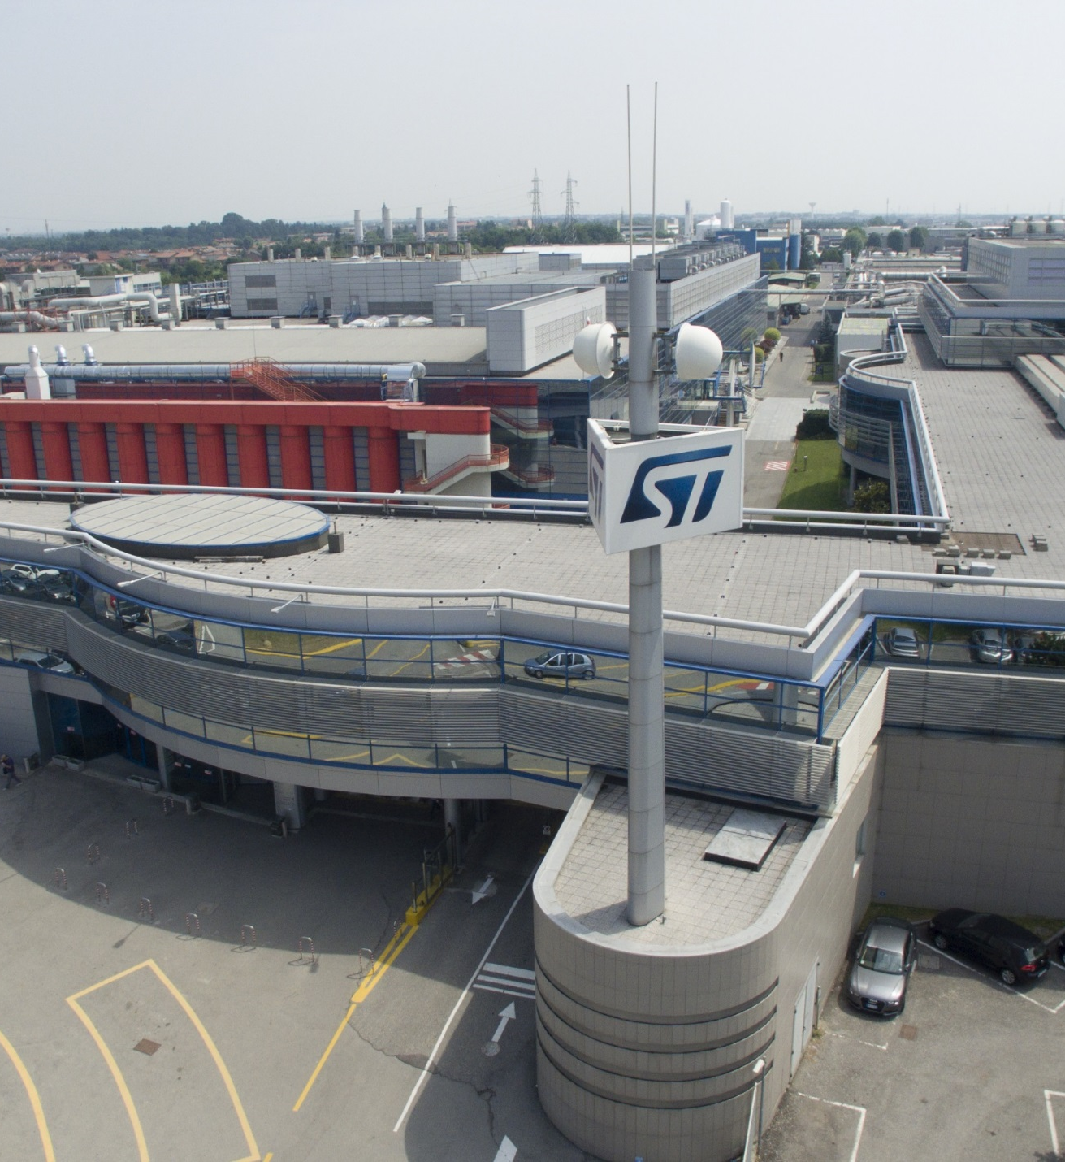
Università degli Studi di Brescia
16 February 2024

Slide 2
Agenda
09:00 | STMicroelectronics
09:20 | Electronics for a Smart and Sustainable World
10:00 | Silicon Journey
10:45
11:00 | From Atoms to Devices and Systems: a multiscale approach to nanoelectronics
11:45 | Window tour R2 and CNR lab tour
12:45 | Professional figures and skills in ST
13:15

