Slide 1
Erasmus Incoming Students INFORMATIVE MEETING Academic Year 2023/24 February 13th 2024

Slide 2
Arrival at Unibs Documents required
Upload on personal page
on Unibs.it
ID/Passport
Photo (passport-like)
EU Health Insurance Card
Visa for study & Private Health Insurance (non EU students ONLY)
To be uploaded on the google form
Arrival certificate (provided by your Home Institution) beginning: start of the academic activities in Brescia (welcome day or beginning of classes) To be sent to: erasmus.incoming@unibs.it

Slide 3
Tax Code (codice fiscale)
It is a code based on your personal details (date/place of birth) issued by the Tax Agency (Agenzia delle Entrate).
You need it for signing contracts (e.g. to rent an apartment, to buy an italian SIM card, etc.).
Unibs system has calculated the code but in order for it to be official it has to be certified by the Tax Agency (Agenzia delle Entrate).
We will provide your tax code as soon as they are ready (via email).
Upload your Photo and ID on your personal page (mandatory!)

Slide 4
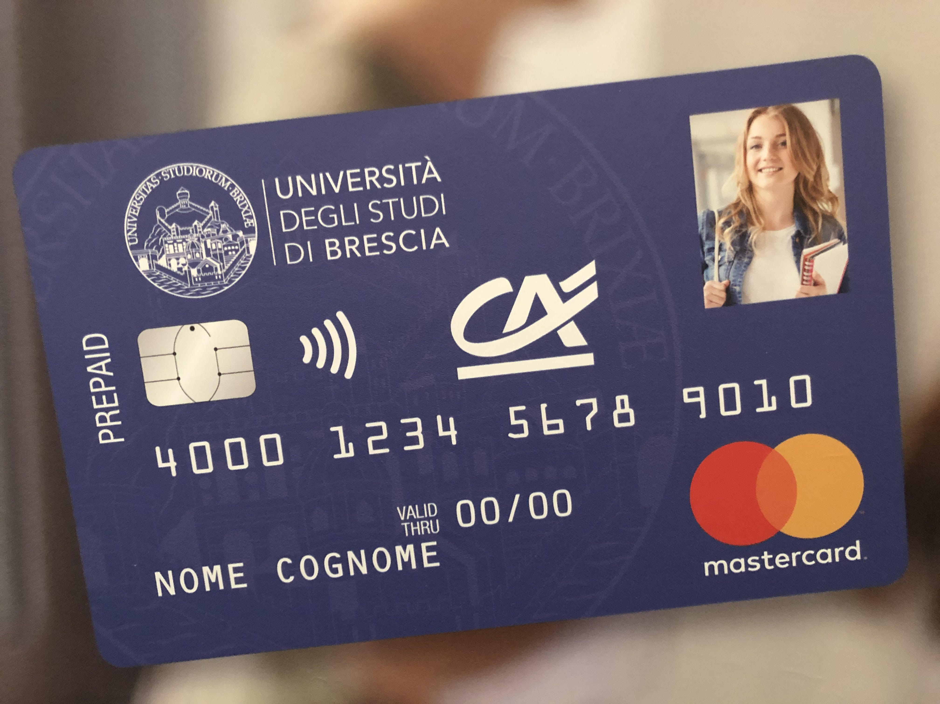
Unibs Student Card
student ID and debit card (optional).
University services (canteen, printers/photocopiers, libraries)
discounts in museums, cinemas, etc
Make sure you have uploaded a profile picture on your personal page!
Where:
At the International Student Mobility DESK
When:
You will receive an email when the card is ready to be collected

Slide 5
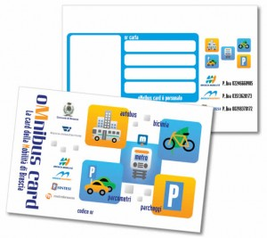
Free Transportation Pass
Offered by Unibs in cooperation with the City Council
The card will be available and active starting from 1st March. It can be used to travel on buses and underground in the city center.
Bike-sharing service can be added on request.
Make sure you have uploaded a profile picture on your personal page!
Where:
To be defined
When:
We will inform you when the cards are ready

Slide 6
Residence permit Additional requirement for non-EU students
All non-EU citizens need to apply for a residence permit (even if they already have a permit in another EU country)
Our Erasmus tutors will help you fill in the application form
Cost for 6 up to 12 months: 100 EUR approx.
Where:
Application forms can be found at any Post Office at «Sportello Amico»
When:
Application must be submitted within 8 working days from arrival

Slide 7
Study plan registration based on your learning agreement
Deadline: 30th March
In order to access MOODLE platform and shared documents AND to take exams, you need to have your study plan registered online.
You will have to go to our Erasmus Tutor desk, where we will help you with the process.
This can be done only when your LA has been signed by all parties.
Go to the desk only when your LA is final! Once registered it cannot be changed
If your study plan is not correctly registered in the system you cannot access Moodle or take exams!

Slide 8
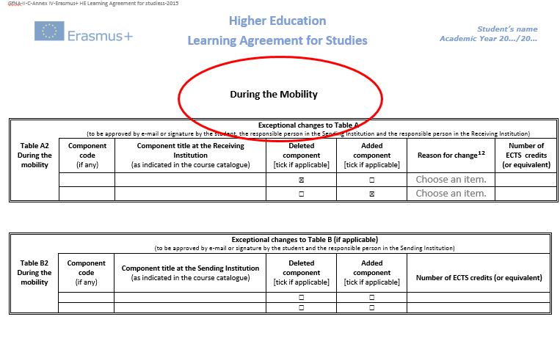
Changes to the Learning Agreement

Slide 9
Changes to the Learning Agreement
Only once per semester
Max 1 month from the beginning of classes
Approved by sending and receiving Institution
“PAPER” LEARING AGREEMENT
Choose the new courses in our offer
Fill in the form and have it signed by your Home University coordinator
Collect the signature of the Unibs coordinator
Send the document to the International Office
OLA
Change your OLA online
Get it approved by home university coordinator
Get it approved by Unibs coordinator
Send a copy to International Office

Slide 10
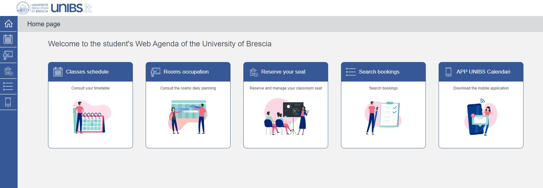
Classes timetable calendari.unibs.it/PortaleStudenti/
Technically you can start attending classes as soon as the semester begins.
Check your schedule and start attending.
Each professor will inform you about the online platform (moodle) where to download any study materials.

Slide 11
Taking exams at Unibs
Booking the exams is mandatory! (20 days up to 5 days before the exam date)
You can find the available calls on our website/personal page.
How to register from your personal page:
open the section «exams»
fill in the survey
give privacy consent (consensi privacy in the menu on page)
book the exam
You won’t be allowed to take exams without registration. Late registration is also not allowed. The International Mobility Office can’t book the exam for you

Slide 12
Taking exams at Unibs
Exams (oral and written) are in presence (face-to-face).
Exception for online exams is made only for students who cannot attend due to Covid related reasons.
Official request to be sent to the Course Council at least one week in advance:
Economics area servizi.didattici.economia@unibs.it
Law area servizididattici.digi@unibs.it
Medical area didattica-ciclounico-med@unibs.it
Engineering area didattica-dicatam-dii-dimi@unibs.it
If you leave Brescia before the exam session is over, you will NOT be able to take the exam online OR after the mobility has ended. Exeptions apply, please contact your academic coordinator.

Slide 13
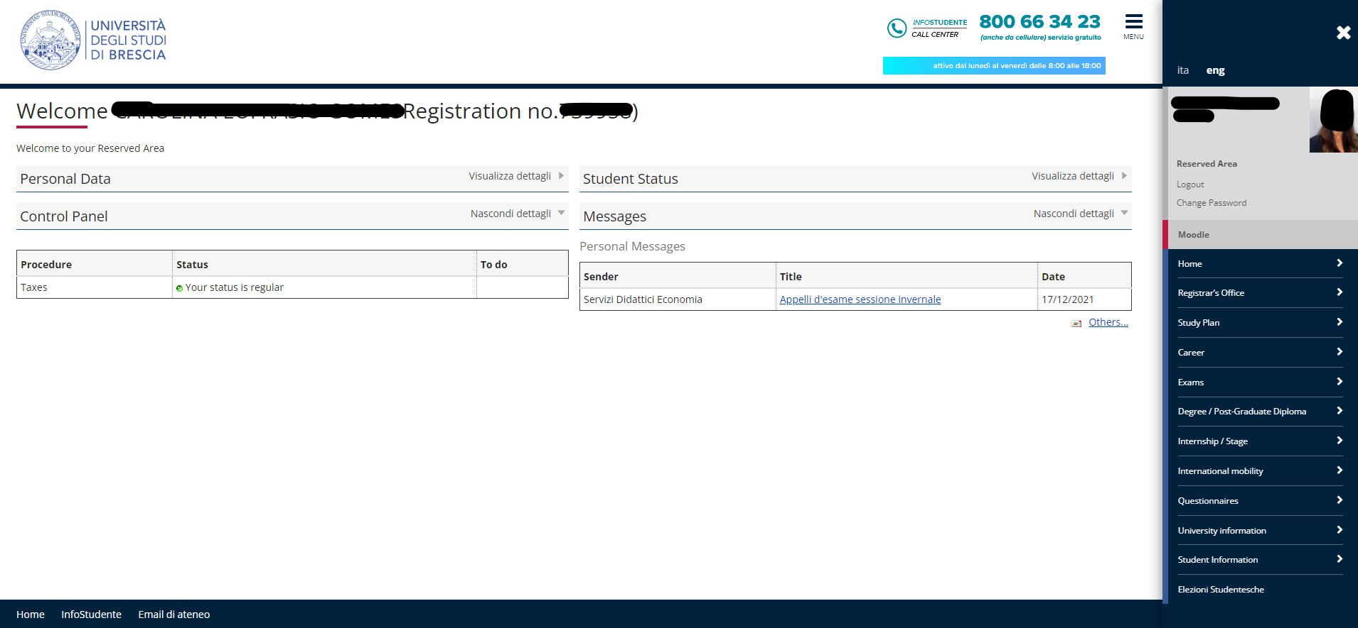
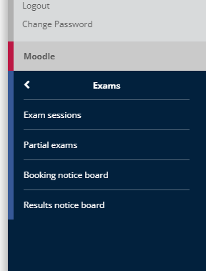
Taking exams at Unibs

Slide 14
Your Unibs email address
Please use your Unibs email address to get in touch with Unibs professors/Offices

Slide 15
Italian Language Course
The Italian Language Course is managed by the Language Teaching Centre (CLA).
Available levels: A1, A2, B1
Calendars will be available on the page of the Language Teaching Centre
Attendance of > 80% of the classes is required to obtain an Open badge.
More information will be given on 21st February during the Welcome Day

Slide 16
Before leaving
Follow the instructions (and deadlines) of the International Student Mobility Office on how to get:
Attendance Certificate (provided by your Home Institution) to be signed and stamped by the International Student Mobility Office at check-out
Transcript of records delivered from Unibs to your Home Institution within 5 weeks from your departure

Slide 17
If you need assistance
Incoming student Tutor Desk
Via San Faustino 74/B / Segreteria studenti
erasmus.tutor@unibs.it
Tutors are students that can help you with classes/timetables/practical information on university life.
Opening hours:
Monday 1.30 pm - 4.30 pm Tuesday 1.30 pm - 4.30 pm Wednesday 1.30 pm - 4.30 pm Thursday 9.30 am – 12.30 pm
Online (by appointment):
Friday 9.30 am - 12.30 pm.

Slide 18
If you need assistance
Departmental coordinators
ECONOMICS & MANAGEMENT DEPARTMENT
Prof. Maria Ruth Dominguez Martin - ruth.dominguez@unibs.it
LAW DEPARTMENT
Prof. Luca Passanante - luca.passanante@unibs.it
ENGINEERING AREA
Civil Engineering, Architecture, Environment & Maths Prof. Roberto Ranzi - roberto.ranzi@unibs.it Mechanical & Industrial Engineering - Prof. Stefano Rebay - stefano.rebay@unibs.it Information Engineering - Prof. Gringoli Francesco - francesco.gringoli@unibs.it Dual degree with Universidad de Almeria Prof. Antonio Visioli - antonio.visioli@unibs.it Dual degree with Sorbonne University Prof. Giovanni Legnani – giovanni.legnani@unibs.it
MEDICINE AREA
Medicine and Dentistry Prof. Corrado Paganelli - corrado.paganelli@unibs.it Sports Prof. Arianna Gnutti – arianna.gnutti@unibs.it
Nursing Prof. Silvia Rossini - silvia.rossini@unibs.it

Slide 19
Next appointment
WELCOME DAY
21st February 2024 | Aula Magna San Faustino
Via San Faustino 74/B
10.00 AM- Institutional Meeting
Welcome speech by our Rector and the Erasmus Departmental Coordinators
Italian Language course presentation, ESN Erasmus Student Network
11.30 - Guided tour in the city center
(fill in the google form if you want to participate)

Slide 20
Enjoy your stay!

